Slide 1
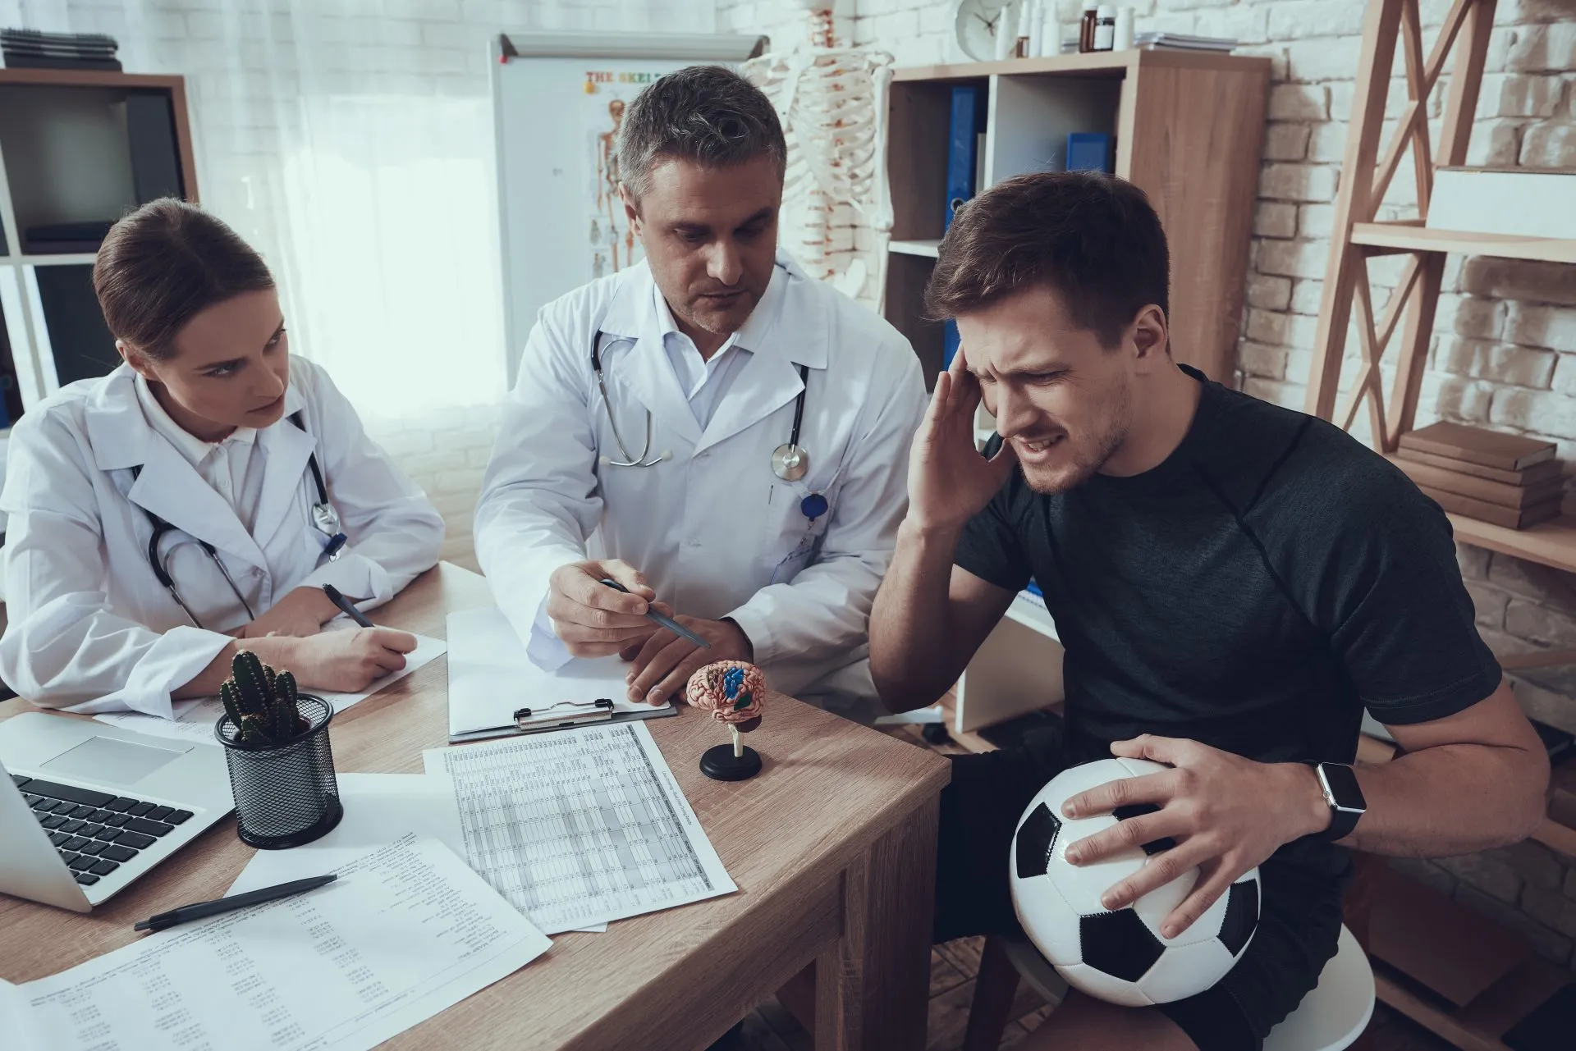
Mental Wellness Athletes

Slide 2

Previous work
1
3
4
2
Worked on process map
Further interviews and research about injury recovery
Completed TSD file for stress management
Started ER diagram for injury recovery

Slide 3
During This Sprint
5
4
3
Improved UI
2
Code for stress management feature
Worked on ERD, Class diagram, TSD file and process map for 2nd feature
1
Improved process map for 1st feature
Documented completed interviews

Slide 4
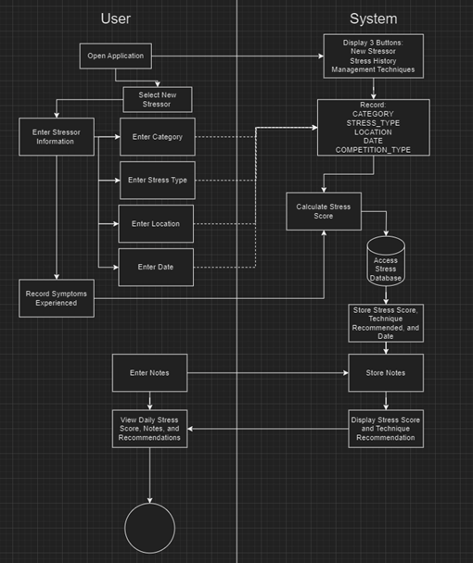
Improved Process Map for Stress Management

Slide 5
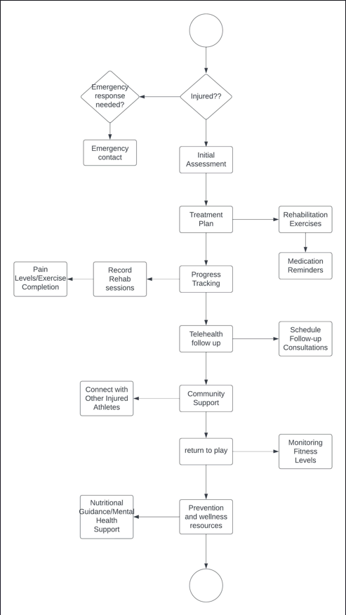


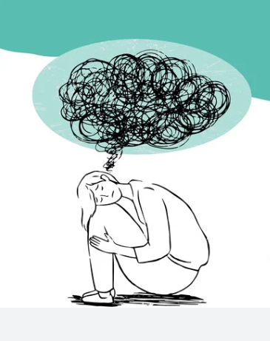
Injury Recovery Process Map

Slide 6
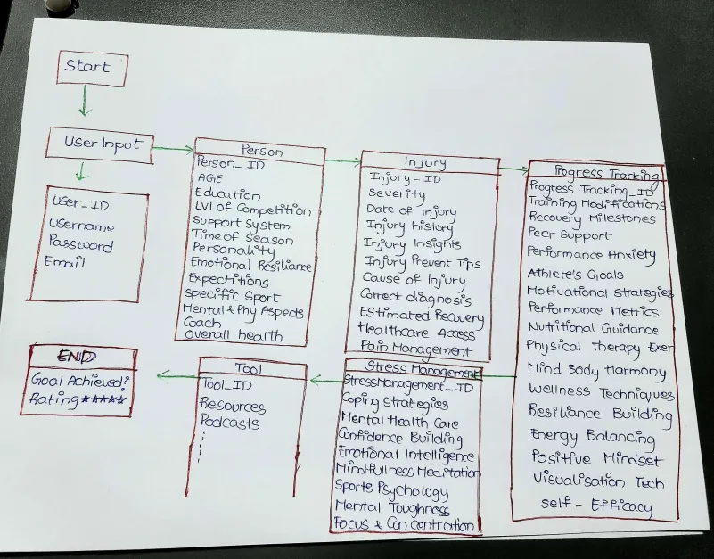



Injury Recovery noun Format

Slide 7
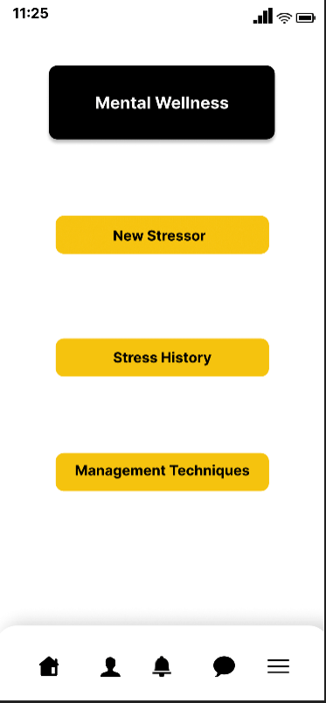

App UI

Slide 8
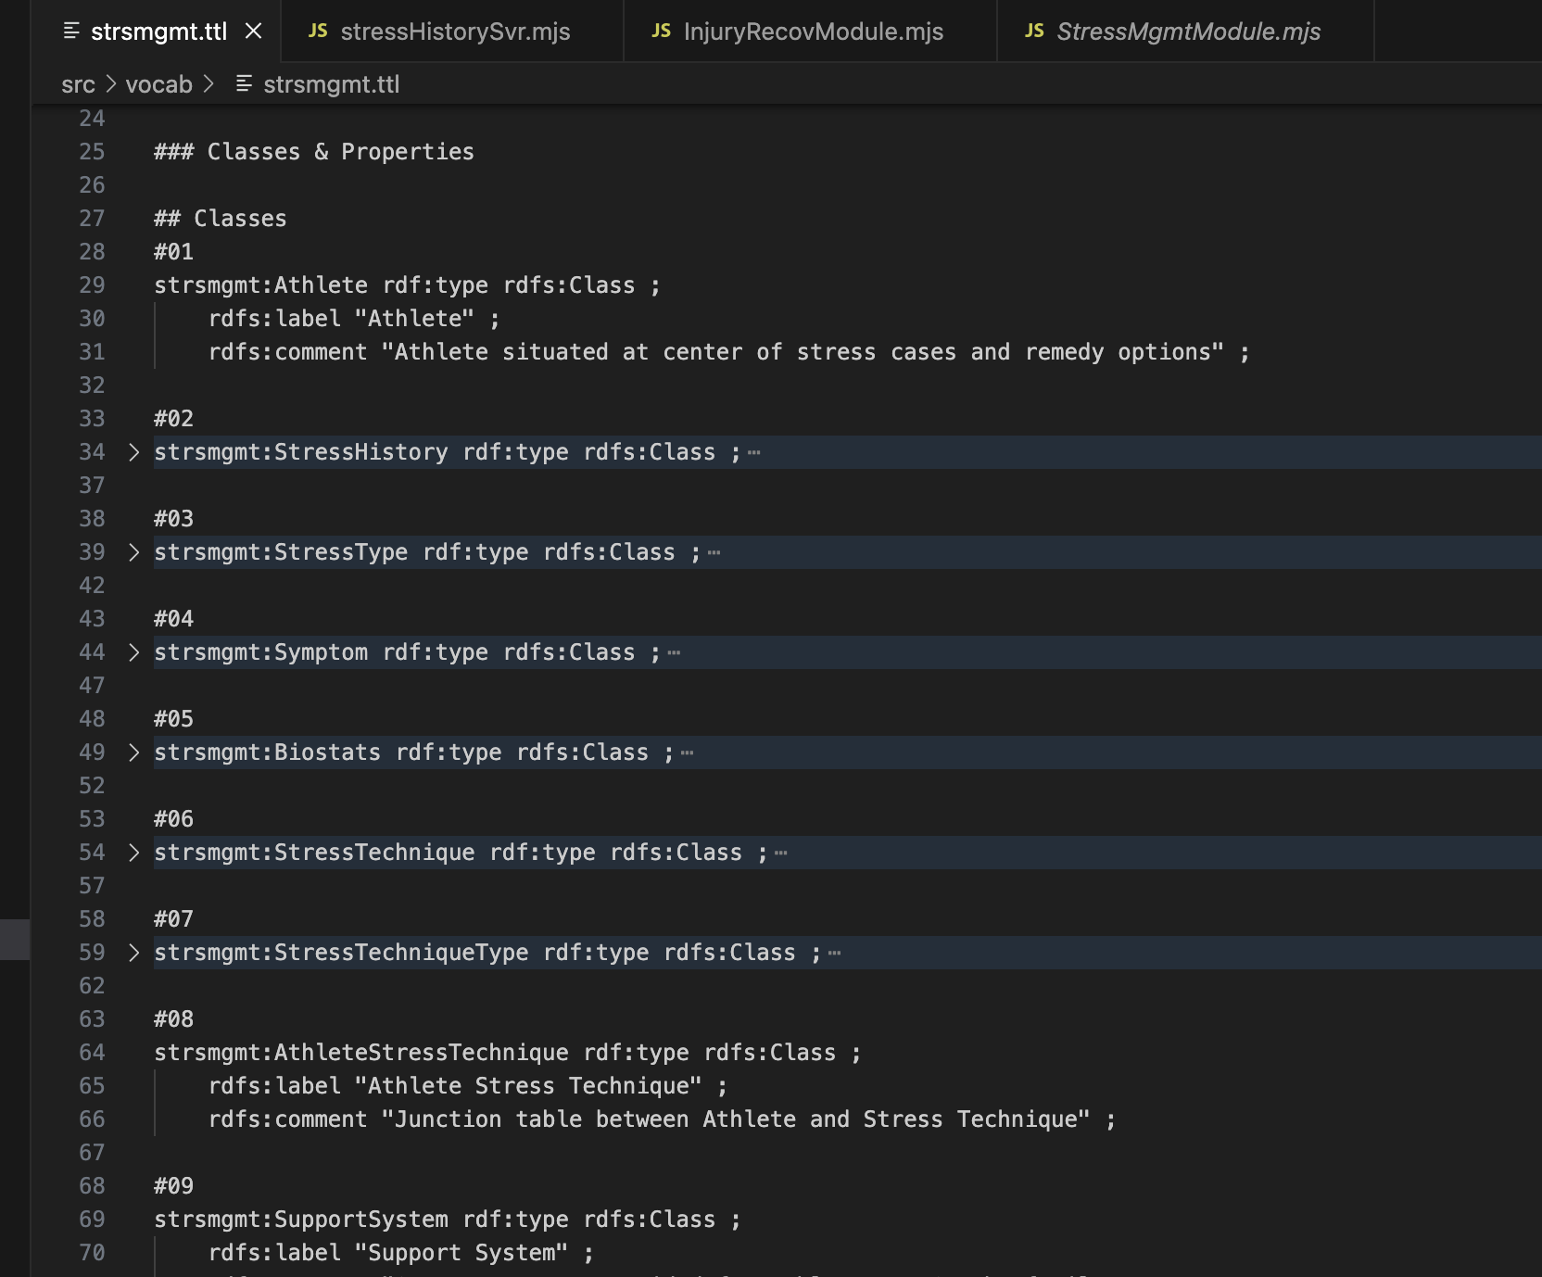
Web Ontology

Slide 9
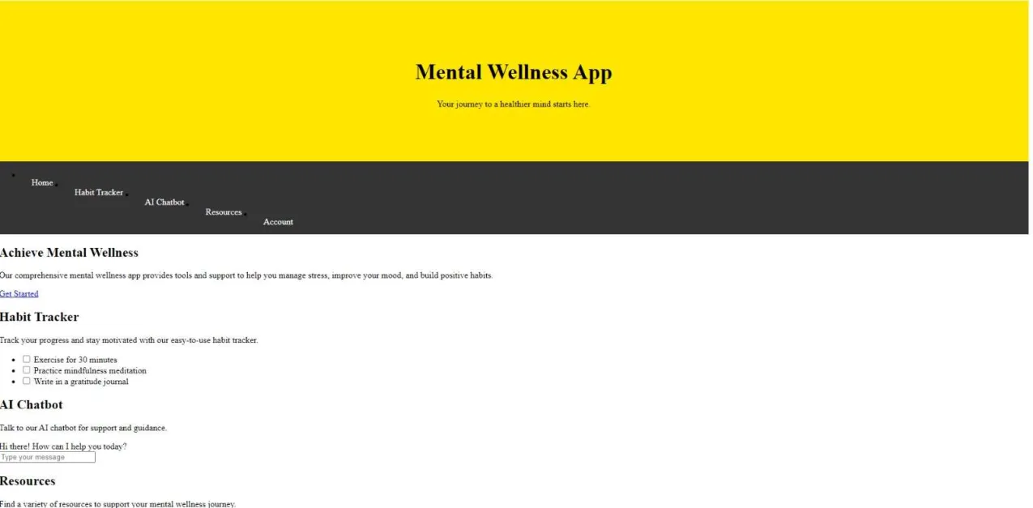

Webpage

Slide 10
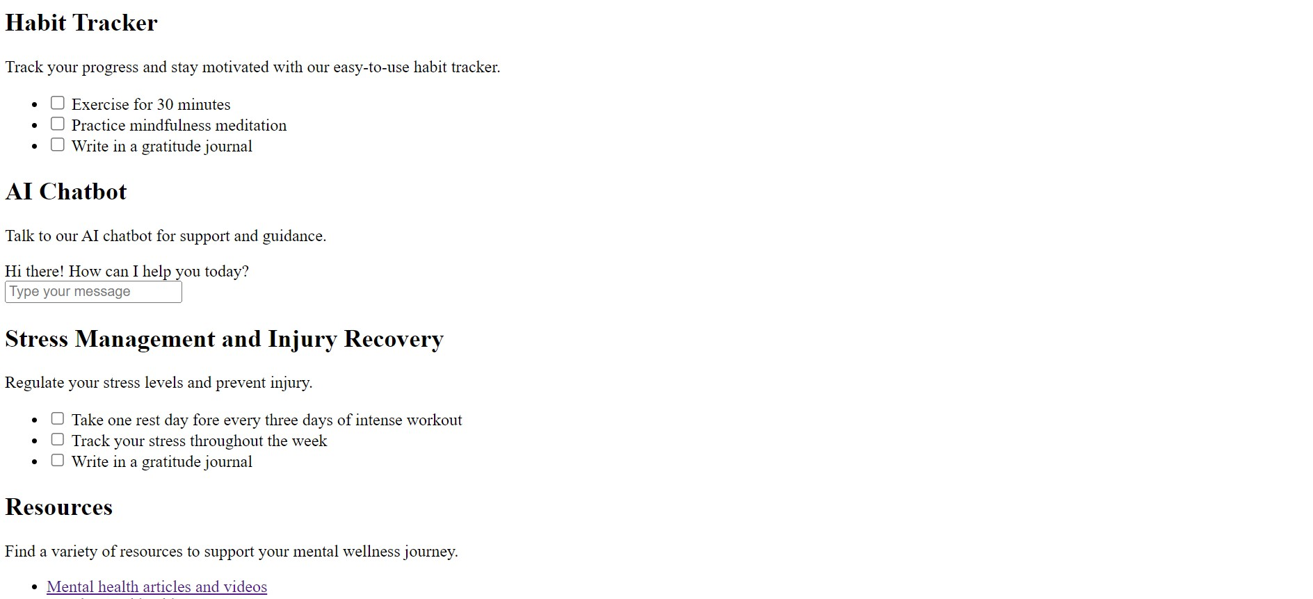
Webpage

Slide 11


Interviews Completed So Far
80%

Slide 12

Future Work
Finish Interviews
Finish ERD, class diagram and TSD for Injury Recovery
Do mockups / improve UI
Product Cost Estimation & Analysis
Start Final Documentation

